Slide 1
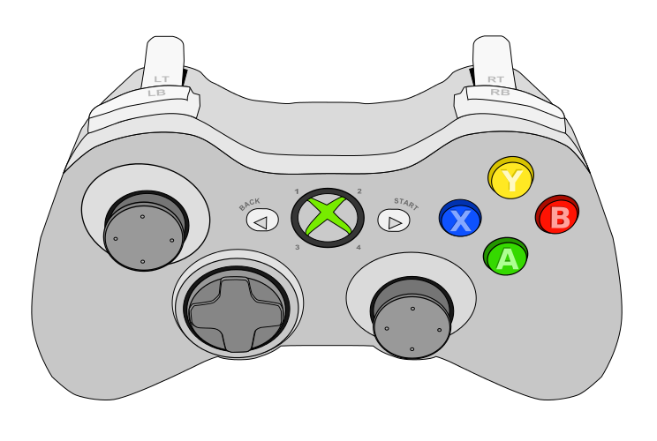
Driver Controller (0)
Retract Intake
Run Intake
Rollers
N/A
N/A
Toggle Deploy/Retract
Intake
Drive Forward
N/A
Strafe Left
Strafe Right
Reset Gyro
Drive Back
Autoalign
X position
Turn Left
Turn Right

Slide 2
Operator Controller (1)
Intake Run
Rollers
Auto
Shoot
N/A
Reset Intake
Shoot
Fuel Pass
N/A
N/A
N/A
N/A
Stop All
Subsystems
N/A
Shoot Position 1
Pulse Pivot Intake
N/A
N/A
N/A
N/A

